Slide 1
Automation
By:
Melven Booysen - 219201277
Siyabulela Gxoyiya - 219288925
Sonwabile Gxoyiya - 219267189
Casey Crafford - 219169640
What are the ethical issues associated with automation?

Slide 2
Contents
Introduction
Idea 1: Ethics around Autonomous Vehicles : Melven
Idea 2: Ethics around Autonomous devices and the Environment : Siyabulela
Idea 3: Ethics around introducing Autonomy in the workplace : Sonwabile
Idea 4: Managing the Ethical Dilemmas of Automation: Casey
Conclusion
Recommendations

Slide 3

Introduction
We chose the topic of automation and the ethical issues surrounding it. After we looked at our sources each of us produced a question.
We look at the application of automation in the automotive Industry and the Ethical issues that surround it.
Additionally, we touch on how automation impacts the environment and the subsequent ethical issues that arise during this process.
Automation in the workplace and the ethical issues in the workplace and the economy.
Although AI is a separate topic, we often refer to it in this presentation as many automation systems work through some type of AI.

Slide 4
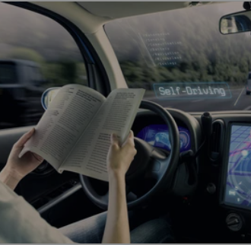

Autonomous vehicle
Autonomous vehicles are self-driven motors that sense their environment to manoeuvre from point A to point B. They do so by collecting real-time traffic data based on cameras and sensors, as well as by exchanging information with other vehicles and the infrastructure. An example of this is the Tesla model vehicles.

Slide 5
Ethics of Autonomous Vehicles
Ethical concerns play a big role in the acceptance of emerging car technology. Furthermore, an article has identified two critical issues based on the ethics of AV.
Firstly, which people at risk should be prioritized in unavoidable accident scenarios, the car occupants or the traffic participants.
Secondly, how to allocate responsibility for accidents, in which people are harmed.

Slide 6
One could hold different participates guilt of this, like;
Holding the manufacturers responsible for a crash caused by the vehicle (AV), since they are ultimately responsible for the final product. But “the liability burden on the manufacturer may be prohibitive of further development.’’ (Marchant and Lindor 2012).
An alternative would be to hold the users of autonomous vehicles responsible for possible accidents. But “the liability of the driver in the case of an accident would be based on their failure to pay attention and intervene”. This will diminish the whole purpose behind the creation of AV vehicles, which is automating driving.

Slide 7
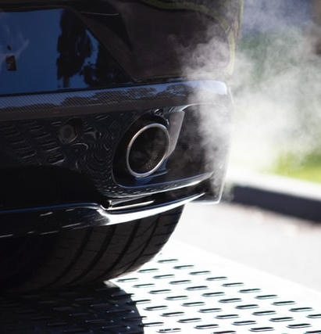
Ethics of Autonomy on the Environment
Automation can have ethical uses that positively impacts the environment.
(Igliński & Babiak, 2017) describe how autonomous vehicles could help in reducing green house emissions, and consume less fuel.

Slide 8

Ethics of Autonomy on the Environment
Automation can also have negative impacts on the environment. Khakurel (2018) mentions 2 effects.
The rate natural resources are extracted and consumed is increased
This greatly increases production of machines and environmental degradation
Planned Obsolesce, machines prematurely wear out and need to be replaced
Both increase waste pollution

Slide 9
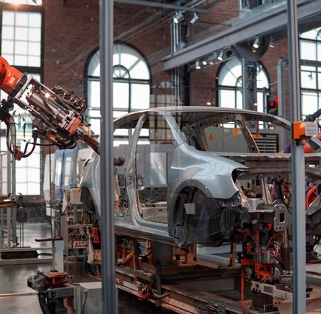
Introducing Autonomy in the Workplace
Automation is introduced in the form of Artificial Intelligence that exists in robots, data collection, monitoring employees when working, measuring performances in the workplace.
Photo by Lenny Kuhne on Unsplash

Slide 10
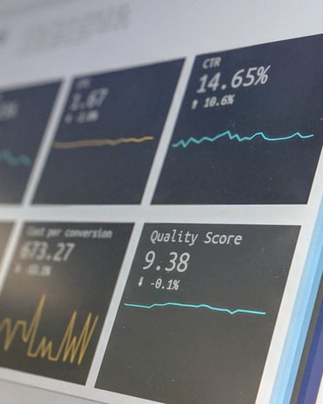
Ethics around introducing Autonomy in the work place
A.I used for monitoring workers when performing tasks. The methods used for monitoring (keylogging, facial recognition, measuring the quality of work.) can add pressure to workers and invade workers privacy rights. can create mistrust in the environment.
Photo by Stephen Dawson on Unsplash

Slide 11
Employee Interests vs Company Interests
Businesses may favour worker-substituting technologies, choosing to replace workers with automation rather than placing them side by side for financial reasons, introducing job insecurity to workers and affecting mental health.
Some benefits to automation for the workers include reducing time and effort on repeatable tasks while upholding the quality of the work and allowing the worker to do more tasks.

Slide 12
Impact of Automation in companies and the economy
Companies who want to remain competitive in their respective industries will want to cut on costs to generate as much income as possible. Therefore company would turn to Automise many departments.
The job market will become smaller and highly competitive.

Slide 13

Managing Automation: Employment, inequality and ethics in the digital age
Mathew Lawrence, Carys Roberts and
Loren King

Slide 14

Ideas Expressed
The main ethical issues addressed:
Job loss
Wage, wealth and power inequalities
The main ideas:
The work scene changing and not being replaced
Creating policy that will prevent the rise of inequality

Slide 15
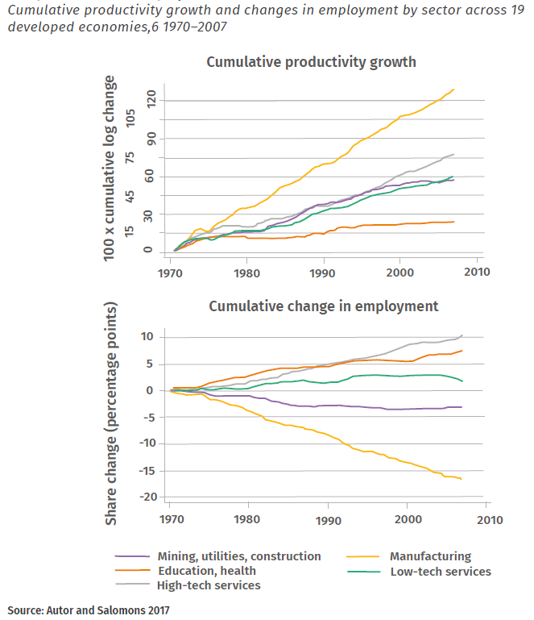
Job Loss
The most worrying ethical issue
Manufacturing is highly affected
Output increasing while employment numbers are decreasing
Are they needed elsewhere?

Slide 16
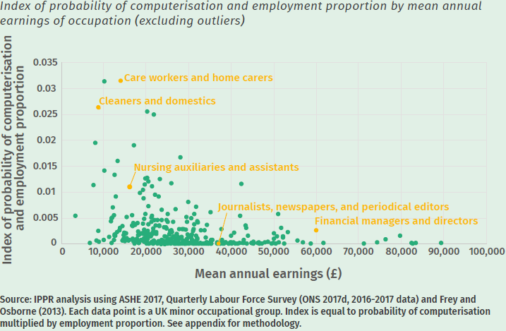
Inequalities
Wage, wealth, power, gender and race
Lower income-greater risk of replacement
In the UK: women and certain ethnic groups at higher risk
The fix: policy

Slide 17

An Area of the Research for Improvement
"As automating technologies are increasingly introduced, rising labour productivity will cause a decline in the numbers of some kinds of jobs in some sectors. These are likely to be offset by an increase in the demand for labour in other sectors, and in other kinds of jobs."
(Lawrence, Roberts and King, 2017)

Slide 18
Conclusion
Automation for workplaces can greatly reduce the workload and save on costs but can introduce pressure and replace large amounts of manual workers.
The lack of establishing concrete regulations and ethical standards compromises this industry from flourish and is important for this to happen so that we can rip from these benefits.
Automation impacts the environment in both positive and negative ways.
When looking at automation in the workplace, Lawrence, Roberts and King believe the introduction of an authority dedicated to managing the use of automation in the workplace will prevent some of the ethical issues raised, such as job loss and inequality.

Slide 19
Recommendations
Student Name | Research Question
Sonwabile Gxoyiya | The Ethics of automation in business and how it affects the workers and the business itself.
Melven Booysen | Should automation be limited and too what extent should the line be drawn on automation implementation in our society/ community?
Casey Crafford | Should countries focus on creating a new authority specifically catered to the management of automation in the workplace?
Siyabulela Gxoyiya | What are the ethical impacts automation has on the environment?

Slide 20
Bibliography
Igliński, H. & Babiak, M., 2017. Analysis of the Potential of Autonomous Vehicles in Reducing the Emissions of Greenhouse Gases in Road Transport. Procedia Engineering, Volume 192, pp. 353-358.
Khakurel, J. et al., 2018. The Rise of Artificial Intelligence under the Lens. Technologies, 11.Volume 6.
Lawrence, M., Roberts, C. and King, L., 2017. Managing automation: Employment, inequality and ethics in the digital age. Institute for Public Policy Research, London.
Vrščaj, D., Nyholm, S. and Verbong, G.P.J. (2020). Is tomorrow’s car appealing today? Ethical issues and user attitudes beyond automation. AI & SOCIETY.
Christoph, J. N. (2019). Ethics and the Workplace Automation. 7. Retrieved September 5, 2021, from https://www.ibe.org.uk/uploads/assets/14ab34e7-4530-48a2-972f709a64d88940/2019-Winning-Essay-Undergraduate.pdf
Photo of rubbish on a beach by Antoine GIRET on Unsplash
Photo of car exhaust by Matt Boitor on Unsplash

